Slide 1

Lyme Disease Prevention: A Cost Analysis
Jared Boorky, Jimmy Clemson,
Yuriy Geller and Andy Vietmeier

Slide 2

What is Lyme Disease?
A disease transmitted by a bite from a black legged tick.
Symptoms: fever, headache, fatigue, and a characteristic skin rash called erythema migraines.
If left untreated, infection can spread to joints, the heart, and the nervous system.

Slide 3

How Ticks Spread the Disease
Ticks feed from mammals, birds, reptiles, and amphibians
The ticks need to have a new host at each stage of their life
They will wait for a host, resting on the tips of grasses and shrubs in a position known as "questing”
When a host brushes the spot where a tick is waiting, it moves to the host

Slide 5
How Ticks Spread the Disease (cont.)
A tick will use a feeding tube to eat
The feeding tubes will secrete a cement-like substance that keeps them firmly attached during the meal
The tubes can also have barbs to help keep the tick in place
Ticks can also secrete an anesthetic in their saliva so it will go unnoticed to the host

Slide 6
How Ticks Spread the Disease (cont.)
If the host animal has certain bloodborne infections, such as the Lyme disease agent, the tick may ingest the pathogen and become infected
When the tick moves on to humans, this will spread the infection
Once infected, a tick can transmit infection throughout its life
Removing the tick quickly can help fend off the infection
According to the CDC, removing the tick within 24 hours will reduce the risk as it takes times for the Lyme bacteria to move from the tick to the host

Slide 7
The Number of Cases
The number of reported cases of Lyme disease in the United States has tripled since the late 1990s
Many cases will go unreported
The number is expected to continue to rise in the coming years
Climate changes will help foster better environments for the ticks who prefer a hot and humid climate to help in their development
In a study done by Carnegie Mellon University, they predicted that if the temperature continues to rise by 2 degrees a year, the number of cases will increase by 21 percent per year

Slide 9
Lyme Disease in 2012 vs 2017

Slide 10
The Cost of the Disease
For new cases, the NIH estimates cost of 3.94 billion over a 5 year period
Some estimate are much higher at $3 billion a year by itself
Individual cases will cost $4,273 and indirect costs of $7,484 per Lyme patient
While this does not compare with the costs of cancer ,influenza and others it will directly compare with more well publicized illnesses like West Nile Disease and Zika Virus
There are an estimated 1-3 million people with chronic Lyme disease which has an estimated associated cost of $75billion

Slide 11
The Disease in Connecticut
Connecticut, like the rest of the northeast, has one of the highest instances of Lyme Disease in the country
The likelihood of the disease increases for the elderly and stays relatively constant until age 50 with a slight spike from 10-19

Slide 12
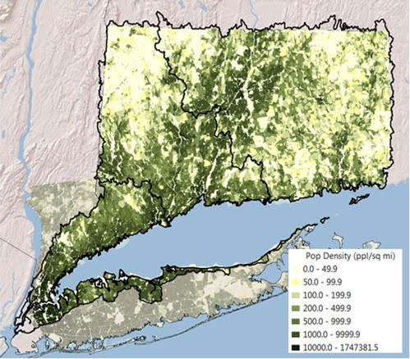
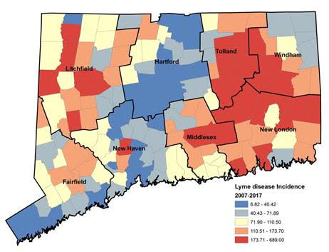
Connecticut Lyme Disease vs Population Density

Slide 13
The Disease In Connecticut (cont.)
The emergence of Lyme disease in Connecticut is attributed in large part to changes in land use. Land that at one time was used for farming has become reforested and increasingly developed for suburban residential use.
These changes help support growth and expansion for the tick population in Connecticut.

Slide 14
Disease Prevention

Slide 15
Disease Prevention
There are many forms of disease prevention but as with any method, each come with their own associated costs and probability of success.
On top of the cost of each method, each will have their own environmental impact which needs to be considered.
The methods can range from large scale methods such as pesticides, like Deltamethrin and Cyfluthrin, to methods that help curb the spread through wildlife such as 4 posters and fencing.
There are also induvial and single home methods such as tick tubes and Pyrethrin soap.

Slide 16
Disease Prevention (cont.)
When constructing our analysis, we looked to find figures on each methods number of applications per year, cost per application, overall success rate and the environmental impact.
Each of these figured was moved into a spread sheet and used to find our objective.

Slide 17
Our Objective and Methods
After our research, our objective was to maximize the effectiveness of the prevention method while minimizing overall cost and minimizing the environmental impact.
Our function was run at different levels of cost to show the best methods of prevention on a small county level to a large park/county level.
When looking at what method to use for our model we settled on Multi-Goal and Stochastic models.

Slide 18
Costs of Application
 | Cost and Coverage
Method | Average % Reduction | Applications Per Year April-Sept | Cost Per Application Per Acre | Labor Per Application Per Acre | Total Cost Per Year Per Acre
Bifenthrin | 100% | 4 | $ 2.56 | $ 7.50 | $ 40.24
Cyfluthrin | 93% | 4 | $ 64.59 | $ 7.50 | $ 288.36
Deltamethrin | 99% | 4 | $ 1.40 | $ 7.50 | $ 35.60
Chlorpyrifos | 96% | 4 | $ 33.72 | $ 7.50 | $ 164.88
Diazinon | 54% | 4 | $ 24.97 | $ 7.50 | $ 129.88
Carbaryl | 86% | 4 | $ 4.00 | $ 7.50 | $ 46.00
Fungal | 87% | 4 | $ 10.00 | $ 5.00 | $ 60.00
Permethrinª | 7% | 4 | $ 19.34 | $ 7.50 | $ 107.36
Fipronil^{b} | 96% | 1 | $ 231.57 | $ 7.50 | $ 239.07
Doxycyline hyclate baitª | 37% | 2 | $ 1,000.00 | $ 7.50 | $ 2,015.00
Vaccine with E. coliexpressing OspA^{b} | 53% | 2 | $ 1,000.00 | $ 7.50 | $ 2,015.00
Deer Control | 0% | 1 | $ 1.00 | $ - | $ 1.00
4-poster device | 71% | 0.07 | $ 0.83 | $ 58.80 | $ 3.98
Pyrethrin soap | 79% | 8 | $ 10.62 | $ 7.50 | $ 144.96
Natural Methods | 74% | 5 | $ 29.95 | $ 7.50 | $ 187.25
Deer fence | 49% | 0.2 | $ 384.78 | $ 1.00 | $ 77.16
Tick Tubes | 28% | 2 | $ 109.44 | $ 7.50 | $ 233.88

Slide 19
Environmental Impact
Environmental impact was an important factor in our decision
Per research, each treatment option was given a weight which was then used in each of our functions
Acaricide application had the highest negative weight due to its effect on wildlife and habitat

Slide 20
Environmental Impact and Weights
 | Weights
Method | total weight as range from 1-0 | Reduction in entomological risk | Impacts of adverse health effects | Impact on habitat | Impact on wildlife | Level of public acceptance | Proportion of population benefitting from intervention | Level of public awareness | Sustainability of effect | Method category
Bifenthrin | 0.005 | 3 | (2) | (16) | (12) | 1 | 2 | - | 1 | Small scale acaricide application
Cyfluthrin | 0.005 | 3 | (2) | (16) | (12) | 1 | 2 | - | 1 | Small scale acaricide application
Deltamethrin | 0.005 | 3 | (2) | (16) | (12) | 1 | 2 | - | 1 | Small scale acaricide application
Chlorpyrifos | 0.005 | 3 | (2) | (16) | (12) | 1 | 2 | - | 1 | Small scale acaricide application
Diazinon | 0.005 | 3 | (2) | (16) | (12) | 1 | 2 | - | 1 | Small scale acaricide application
Carbaryl | 0.005 | 3 | (2) | (16) | (12) | 1 | 2 | - | 1 | Small scale acaricide application
Fungal | 0.203 | 3 | - | (1) | (1) | 4 | 4 | 2 | 3 | Natural acaricide application
Permethrinª | 0.005 | 3 | (2) | (16) | (12) | 1 | 2 | - | 1 | Small scale acaricide application
Fipronil^{b} | 0.005 | 3 | (2) | (16) | (12) | 1 | 2 | - | 1 | Small scale acaricide application
Doxycyline hyclate baitª | 0.096 | 1 | (2) | (3) | (8) | 3 | 2 | - | 1 | ‘Damminix’ device
Vaccine with E. coliexpressing OspA^{b} | 0.160 | - | (2) | (1) | (1) | 3 | 4 | 1 | 2 | Vaccination
Deer Control | 0.043 | 2 | (2) | (3) | (18) | 2 | 2 | - | 1 | Deer hunting
4-poster device | 0.091 | 3 | (2) | (3) | (12) | 3 | 2 | - | 2 | ‘4-poster' device
Pyrethrin soap | 0.005 | 3 | (2) | (16) | (12) | 1 | 2 | - | 1 | Small scale acaricide application
Natural Methods | 0.203 | 3 | - | (1) | (1) | 4 | 4 | 2 | 3 | Natural acaricide application
Deer fence | 0.059 | 2 | (1) | (12) | (6) | 1 | 2 | - | 1 | Exclusion of deer by fencing
Tick Tubes | 0.096 | 1 | (2) | (3) | (8) | 3 | 2 | - | 1 | ‘Damminix’ device

Slide 21
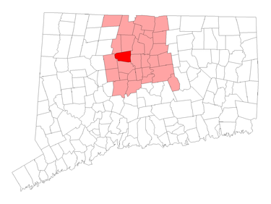
Model 1- Small County Application
Avalon, Connecticut
Total Land- 23.5 sq miles
Total Population- 18,302
Population Denisity- 781.6/sq mile

Slide 22
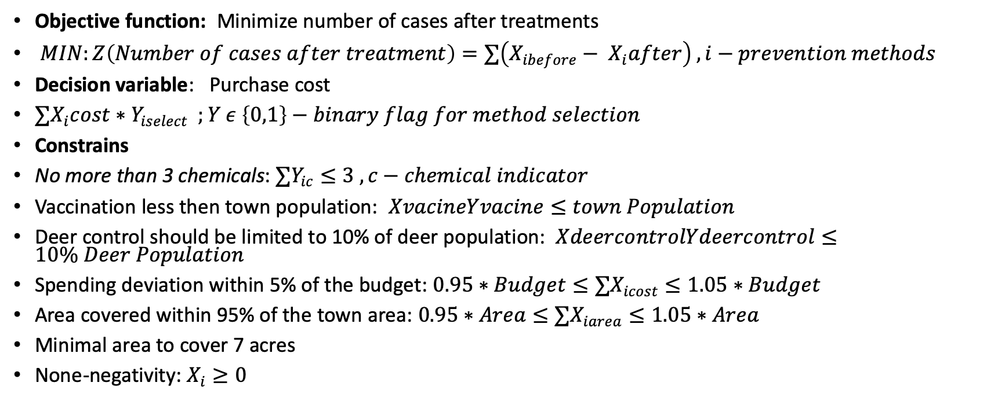
Model 1 – Small County Application (cont.)
Objective function: Minimize number of cases after treatments
$MIN:Z\left(Number of cases after treatment\right)=∑\left(X_{ibefore}− X_{i}after\right) , i−prevention methods$
Decision variable: Purchase cost
$∑X_{i}cost∗Y_{iselect} ;Y ε \left\{0,1\right\}−binary flag for method selection$
Constrains
No more than 3 chemicals: $∑Y_{ic}≤3 , c−chemical indicator$
Vaccination less then town population: $XvacineYvacine≤town Population$
Deer control should be limited to 10% of deer population: $XdeercontrolYdeercontrol≤10\% Deer Population$
Spending deviation within 5% of the budget: $0.95∗Budget≤∑X_{icost}≤1.05∗Budget$
Area covered within 95% of the town area: $0.95∗Area≤∑X_{iarea}≤1.05∗Area$
Minimal area to cover 7 acres
None-negativity: $X_{i}≥0$

Slide 23
Model 1- Small County Application (cont.)
With our objective function, we were able to cover 22,000 acres ft at a cost of $204,978.00. This lead to 218 fewer cases in the area.
The most used methods of control were tick tubes and deer fencing, deer fencing would be used to surround the available areas with fencing to prevent deer population and tick tubes could be used by individuals. Both had 98% effective rates in this model.
Additionally, multiple forms of pesticides were used but in lesser quantities due to their environmental impact, the most used was Cyfluthrin due to its 86% effective rate and relatively low cost per acre per application.

Slide 24
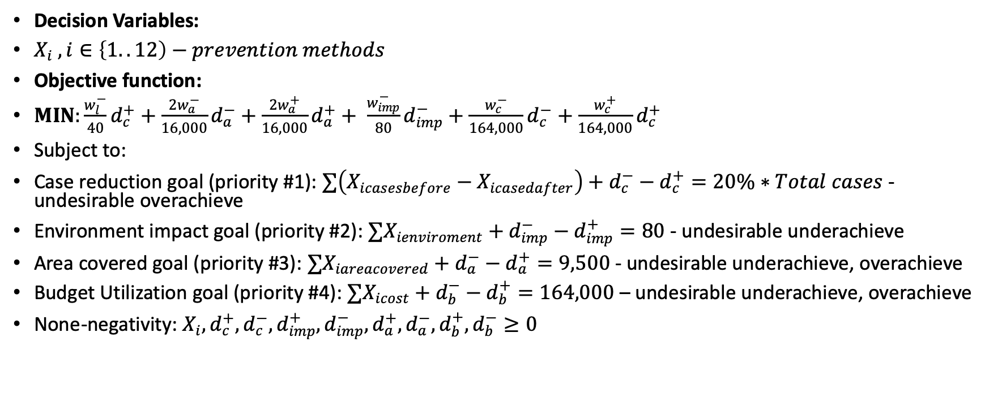
Model 2-Small County Application- Multi Goal
Decision Variables:
$X_{i} , i∈\left\{1..12\right)−prevention methods$
Objective function:
$MIN:\frac{w_{l}^{−}}{40}d_{c}^{+}+\frac{2w_{a}^{−}}{16,000}d_{a}^{−}+\frac{2w_{a}^{+}}{16,000}d_{a}^{+}+ \frac{w_{imp}^{−}}{80}d_{imp}^{−}+\frac{w_{c}^{−}}{164,000}d_{c}^{−}+\frac{w_{c}^{+}}{164,000}d_{c}^{+}$
Subject to:
Case reduction goal (priority #1): $∑\left(X_{icasesbefore}−X_{icasedafter}\right)+d_{c}^{−}−d_{c}^{+}=20\%∗Total cases$ -undesirable overachieve
Environment impact goal (priority #2): $∑X_{ienviroment}+d_{imp}^{−}−d_{imp}^{+}=80$ - undesirable underachieve
Area covered goal (priority #3): $∑X_{iareacovered}+d_{a}^{−}−d_{a}^{+}=9,500$ - undesirable underachieve, overachieve
Budget Utilization goal (priority #4): $∑X_{icost}+d_{b}^{−}−d_{b}^{+}=164,000$ – undesirable underachieve, overachieve
None-negativity: $X_{i},d_{c}^{+}, d_{c}^{−},d_{imp}^{+}, d_{imp}^{−},d_{a}^{+}, d_{a}^{−},d_{b}^{+}, d_{b}^{−}≥0$

Slide 25
Model 2-Small County Application- Multi Goal
When compared to the prior model, this application reduced additional cases and acres for less cost
The total cost was $190,000 which covered 24,150 feet
Cases reduced by 242
This application still focused on a high level of tick tubes but also put more money into the application of pesticides, Fipronil and Nootkatone

Slide 26
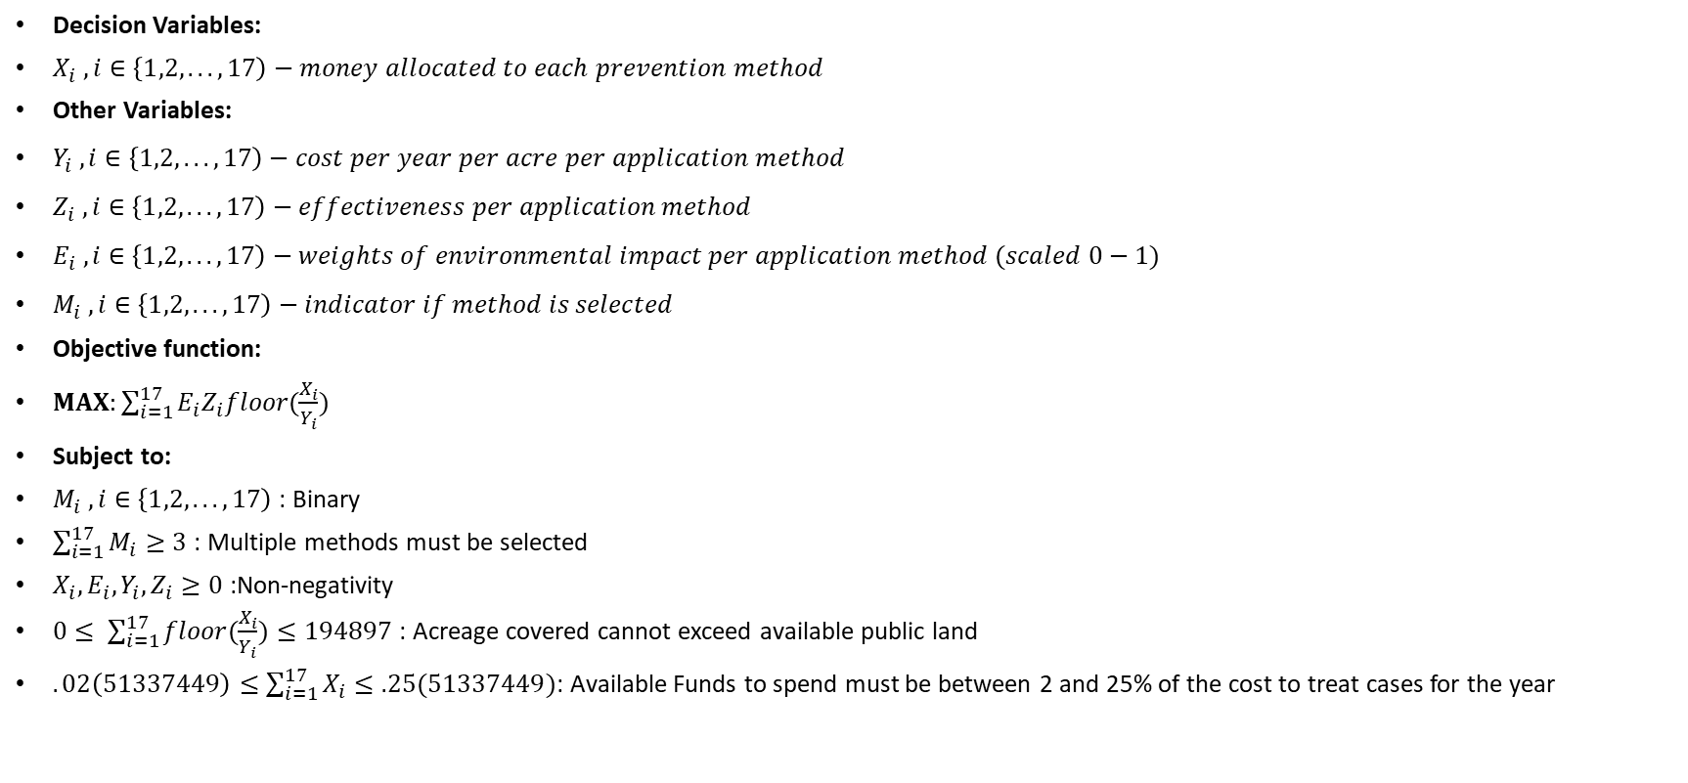
Model 3- Large Scale Application
Decision Variables:
$X_{i} , i∈\left\{1,2,...,17\right)−money allocated to each prevention method$
Other Variables:
$Y_{i} , i∈\left\{1,2,...,17\right)−cost per year per acre per application method$
$Z_{i} , i∈\left\{1,2,...,17\right)−effectiveness per application method$
$E_{i} , i∈\left\{1,2,...,17\right)−weights of environmental impact per application method (scaled 0−1)$
$M_{i} , i∈\left\{1,2,...,17\right)−indicator if method is selected$
Objective function:
$MAX:\sum_{i=1}^{17}{E_{i}Z_{i}floor(\frac{X_{i}}{Y_{i}})}$
Subject to:
$M_{i} , i∈\left\{1,2,...,17\right)$ : Binary
$\sum_{i=1}^{17}{M_{i}≥3}$ : Multiple methods must be selected
$X_{i},E_{i},Y_{i},Z_{i}≥0$:Non-negativity
$0≤ \sum_{i=1}^{17}{floor(\frac{X_{i}}{Y_{i}})}≤194897$ : Acreage covered cannot exceed available public land
$.02\left(51337449\right)≤\sum_{i=1}^{17}{X_{i}≤.25(51337449)}$: Available Funds to spend must be between 2 and 25% of the cost to treat cases for the year

Slide 27
Model 3- Large Scale Application (cont.)
Took total Lyme treatment and spent 25% on prevention
This reduced the total cost on prevention and treatment by about 61%
The total average cases was brought down from 2061 to 280 per year

Slide 28
Conclusion
Currently, the largest limitation to prevention is cost. Many people said they would be unwilling to spend great then $100 on their own land and government funding has not kept up with the rise in cases
However, certain entities, such as The Connecticut Agricultural Experiment Station have taken great leaps forward in research over the last few years with their own tick testing laboratory
Additionally, there are improvements on a vaccination which could lead to future breakthroughs.

